Slide 1
LINEAR CONTROL
SYSTEMS
Ali Karimpour
Assistant Professor
Ferdowsi University of Mashhad
Notes:
<<<1.1>>>
###Control System Design###
{{{Control, Design}}}

Slide 2
Lecture 1
An Introduction to Linear Control Systems
Topics to be covered include:
A brief history of control.
Introducing of some advanced control system.
Important parts of a control system.

Slide 3
History of Control Engineering
Feedback control has a long history which began with the early desire of human to harness the materials and forces of the nature to their advantage. Early examples of control devices include clock regulating systems and mechanisms for keeping wind-mills pointed into the wind.
Modern aeroplanes have sophisticated control systems which are crucial to their successful operation.
Notes:
<<<1.2>>>

Slide 4
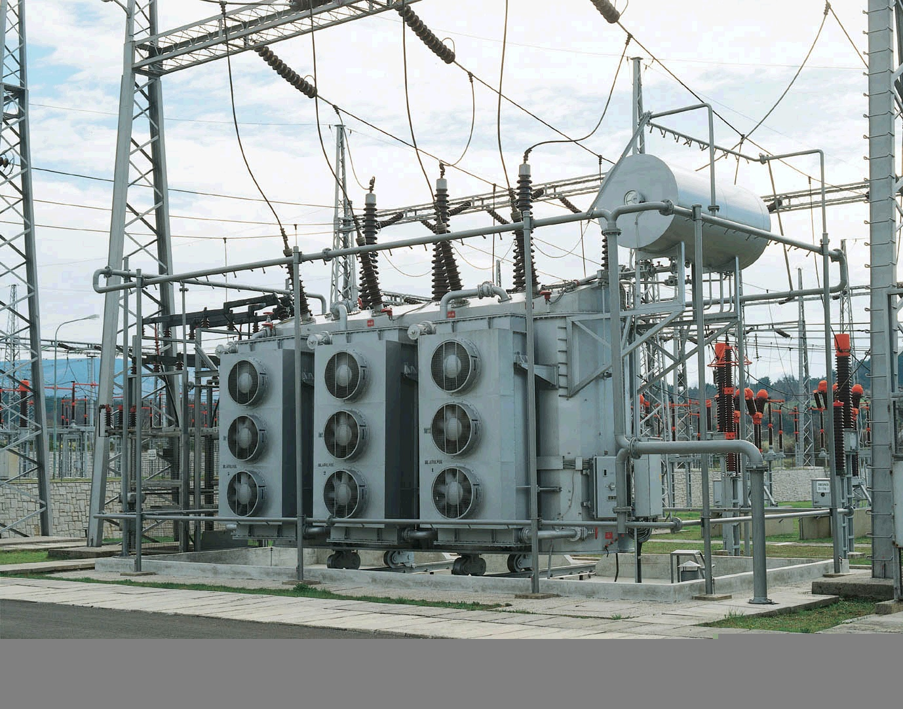
A modern high voltage tranformator

Slide 5
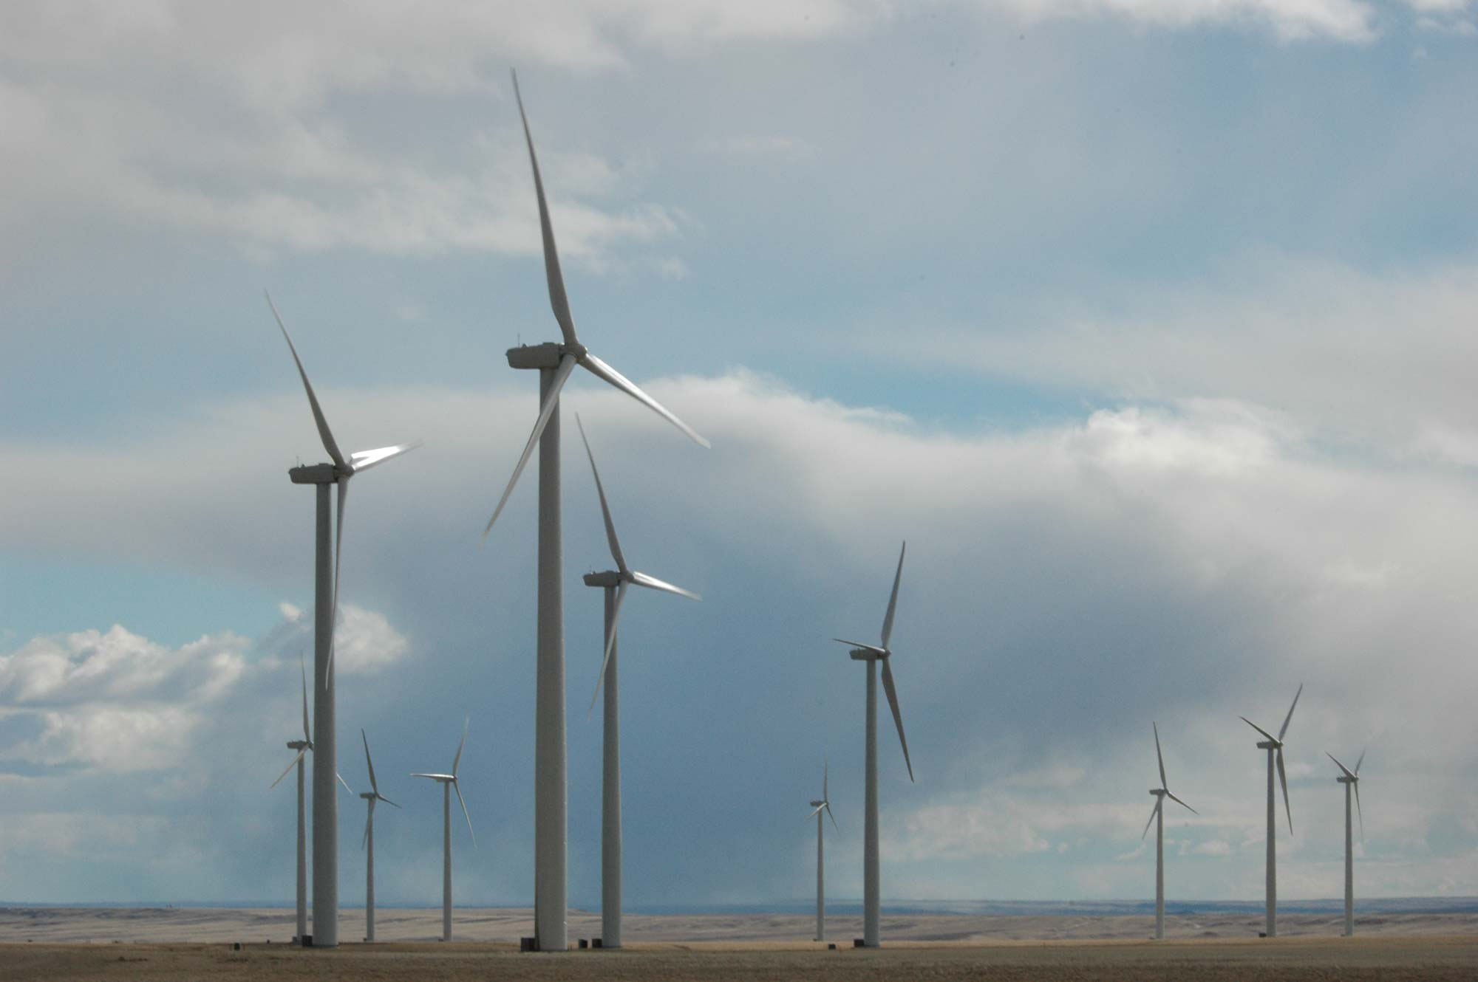
A wind farm

Slide 6
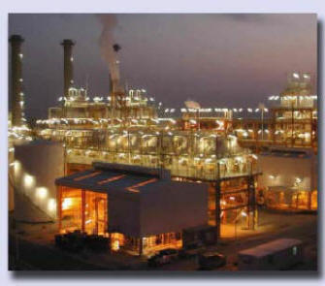
A modern industrial plant: Asalooye south of Iran

Slide 7
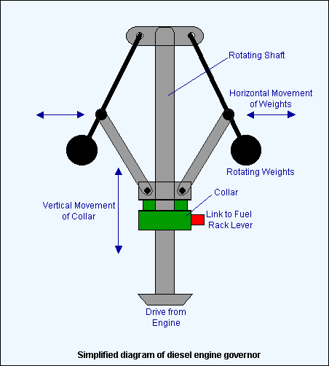
Governor structure
Notes:
{{{cotton mill}}}

Slide 8
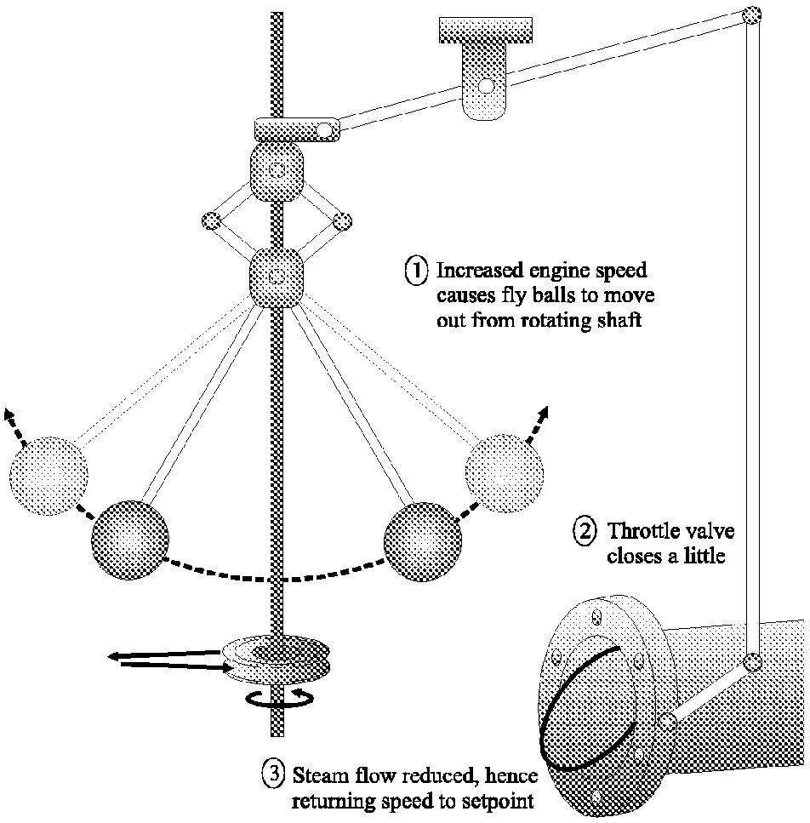
Governor operation
Notes:
{{{cotton mill}}}

Slide 9
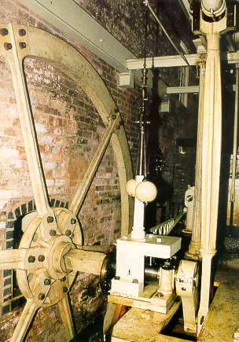
Governor photograph
This photograph shows a flyball
governor used on a steam engine
in a cotton factory near Manchester
in the United Kingdom. Of course,
Manchester was at the centre of the
industrial revolution. Actually, this
cotton factory is still running today.
Notes:
{{{cotton mill}}}

Slide 10
Control benefits
Improved control is a key enabling technology to:
enhanced product quality
waste minimization
environmental protection
greater throughput for a given installed capacity
greater yield, and
higher safety margins

Slide 11
System Integration
Success in control engineering depends on some of the issues:
plant, i.e. the process to be controlled
objectives
sensors
actuators
communications
computing
architectures and interfacing
algorithms
accounting for disturbances and uncertainty
Notes:
<<<1.5>>>
###System Integration###

Slide 12
Plant
The physical layout of a plant is an intrinsic part of control problems. Thus a control engineer needs to be familiar with the "physics" of the process under study. This includes a knowledge of the basic energy balance, mass balance and material flows in the system.
As an example consider an aeroplane, or a room for temperature control.
Notes:
<<<1.5.1>>>

Slide 13
Objectives
Before designing sensors, actuators or control architectures, it is important to know the goal, that is, to formulate the control objectives. This includes
what does one want to achieve (energy reduction, yield increase,...)
what variables need to be controlled to achieve
these objectives
what level of performance is necessary (accuracy, speed,...)
Notes:
<<<1.5.2>>>

Slide 14
Sensors
Sensors are the eyes of control enabling one to see what is going on. Indeed, one statement that is sometimes made about control is:
If you can measure it, you can control it.
As an example consider the altitude sensor in an aeroplane or the temperature in a room
Notes:
<<<1.5.3>>>

Slide 15
Actuators
Once sensors are in place to report on the state of a process, then the next issue is the ability to affect, or actuate, the system in order to move the process from the current state to a desired state
As an example consider the ballet in an aeroplane or the fan in a room
Notes:
<<<1.5.4>>>

Slide 16
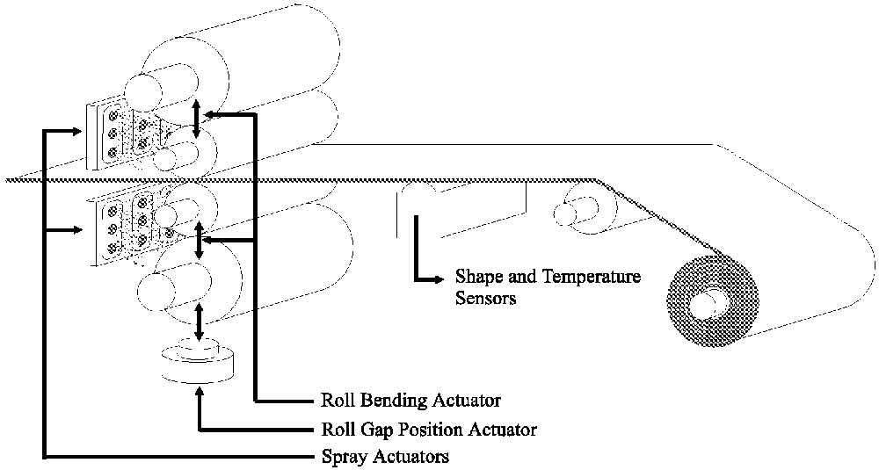
Figure 1.3: Typical flatness control set-up for rolling mill
A typical industrial control problem will usually involve many different actuators - see below:

Slide 17
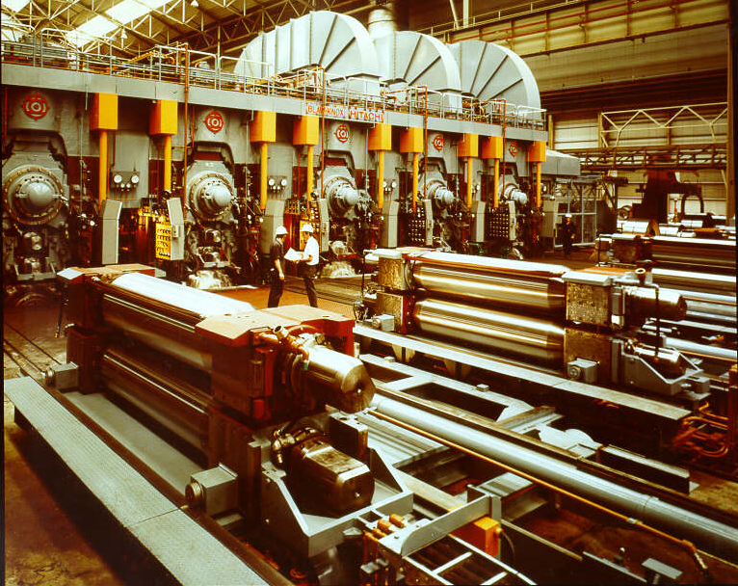
A modern rolling mill

Slide 18
Communications
Interconnecting sensors to actuators, involves the use of communication systems. A typical plant can have many thousands of separate signals to be sent over long distances. Thus the design of communication systems and their associated protocols is an increasingly important aspect of modern control engineering.
Notes:
<<<1.5.5>>>

Slide 19
Computing
In modern control systems, the connection between sensors and actuators is invariably made via a computer of some sort. Thus, computer issues are necessarily part of the overall design. Current control systems use a variety of computational devices including DCS's (Distributed Control Systems), PLC's (Programmable Logic Controllers), PC's (Personal Computers), etc.
Notes:
<<<1.5.6>>>

Slide 20
Architectures and interfacing
The issue of what to connect to what is a non-trivial one in control system design. One may feel that the best solution would always be to bring all signals to a central point so that each control action would be based on complete information (leading to so called, centralized control). However, this is rarely (if ever) the best solution in practice. Indeed, there are very good reasons why one may not wish to bring all signals to a common point. Obvious objections to this include complexity, cost, time constraints in computation, maintainability, reliability, etc.
Notes:
<<<1.5.7>>>

Slide 21
Algorithms
Finally, we come to the real heart of control engineering i.e. the algorithms that connect the sensors to the actuators. It is all to easy to underestimate this final aspect of the problem.
As a simple example from our everyday experience, consider the problem of playing tennis at top international level. One can readily accept that one needs good eye sight (sensors) and strong muscles (actuators) to play tennis at this level, but these attributes are not sufficient. Indeed eye-hand coordination (i.e. control) is also crucial to success.
Notes:
<<<1.5.8>>>

Slide 22
In summary:
Sensors provide the eyes and actuators the muscle but control science provides the finesse.

Slide 23

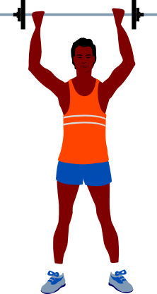

Better Sensors
Provide better Vision
Better Actuators
Provide more Muscle
Better Control
Provides more finesse by combining sensors and
actuators in more intelligent ways

Slide 24
Disturbances and Uncertainty
One of the things that makes control science interesting is that all real life systems are acted on by noise and external disturbances. These factors can have a significant impact on the performance of the system. As a simple example, aircrafts are subject to disturbances in the form of wind-gusts, and cruise controllers in cars have to cope with different road gradients and different car loadings.
Notes:
<<<1.5.9>>>

Slide 25
Control design procedure
Typical steps include:
Assessment of a range of control opportunities;
Developing a short list for closer examination;
Deciding on a project with high economic or environmental impact;
Consulting appropriate personnel (management, operators, production staff, maintenance staff etc.);
Identifying the key action points;
Collecting base case data for later comparison;
Deciding on revised performance specifications;
Updating actuators, sensors etc.;
Notes:
<<<1.5.11>>>

Slide 26
Control implementation
Development of algorithms;
Testing the algorithms via simulation;
Testing the algorithms on the plant using a rapid prototyping system;
Collecting preliminary performance data for comparison with the base case;
Final implementation;
Collection of final performance data;
Final reporting on project.
Notes:
<<<1.5.11>>>

